Slide 1
INFERENCE, REGRESSION, & STORIES
MPA 630: Data Science for Public Management
December 6, 2018
Fill out your reading report on Learning Suite

Slide 2
PLAN FOR TODAY
Why all this simulation?
Inference and regression
Telling stories with data

Slide 3
WHY ALL THIS SIMULATION?

Slide 4
Find δ The sample statistic: diff in means, mean, diff in props, etc.
Invent world where δ is null Simulate what the world would look like if there was no effect.
Look at δ in the null world Is it big and extraordinary, or is it a normal thing?
Calculate probability that δ could exist in the null world This is your p-value!
Decide!

Slide 5
GOAL OF STATISTICS
Make inferences about a whole population using only a sample of the population

Slide 6
MAKING INFERENCES
We have to know how confident we are that the thing we find in the sample reflects the whole population
Confidence intervals
p-values

Slide 7
P-VALUES
The probability of observing an difference or effect at least that large when no difference or effect exists

Slide 8
NULL WORLDS
But how do you determine what δ would look like in a null world?
Option 1: Use math and calculus and formulas to determine probabilities

Slide 9
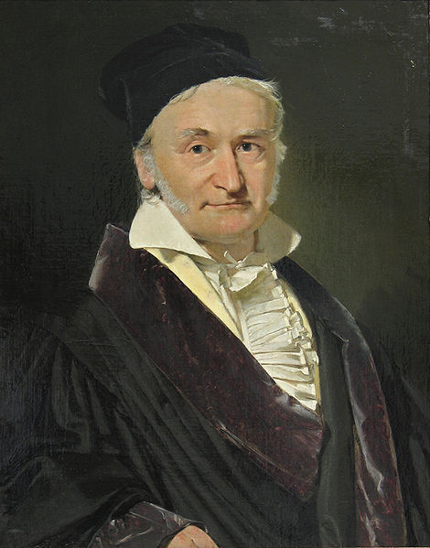
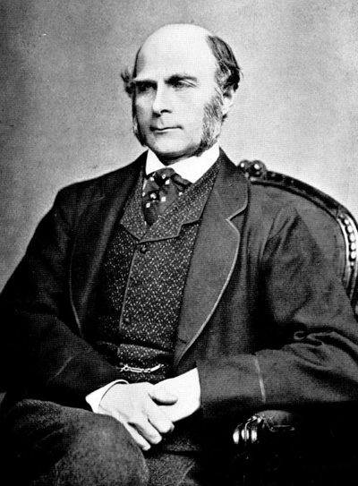
Carl Friedrich Gauss
Francis Galton

Slide 10
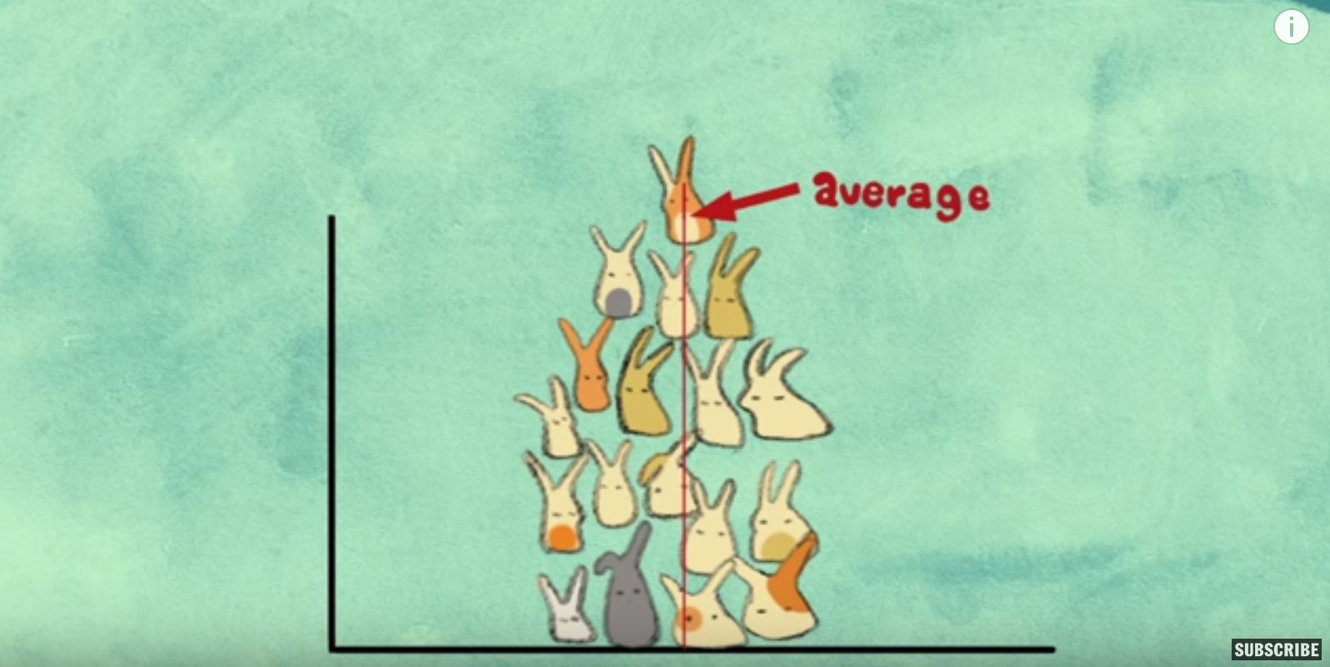
CENTRAL LIMIT THEOREM
https://www.youtube.com/watch?v=jvoxEYmQHNM

Slide 11
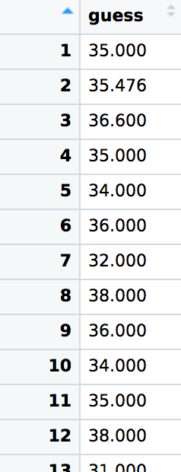
WISDOM OF THE CROWD
Notes:
12405 / 365.25 = 33.9630390144
14 days off!
Rely on the wisdom of the crowd - take the average of a bunch of fairly well informed guesses and you should be fairly accurate
This is how you can win those candy jar guessing games, as long as you’re near the end and you have access to the data
Colleen Kohler: 0
Rich Christianson: 57

Slide 12
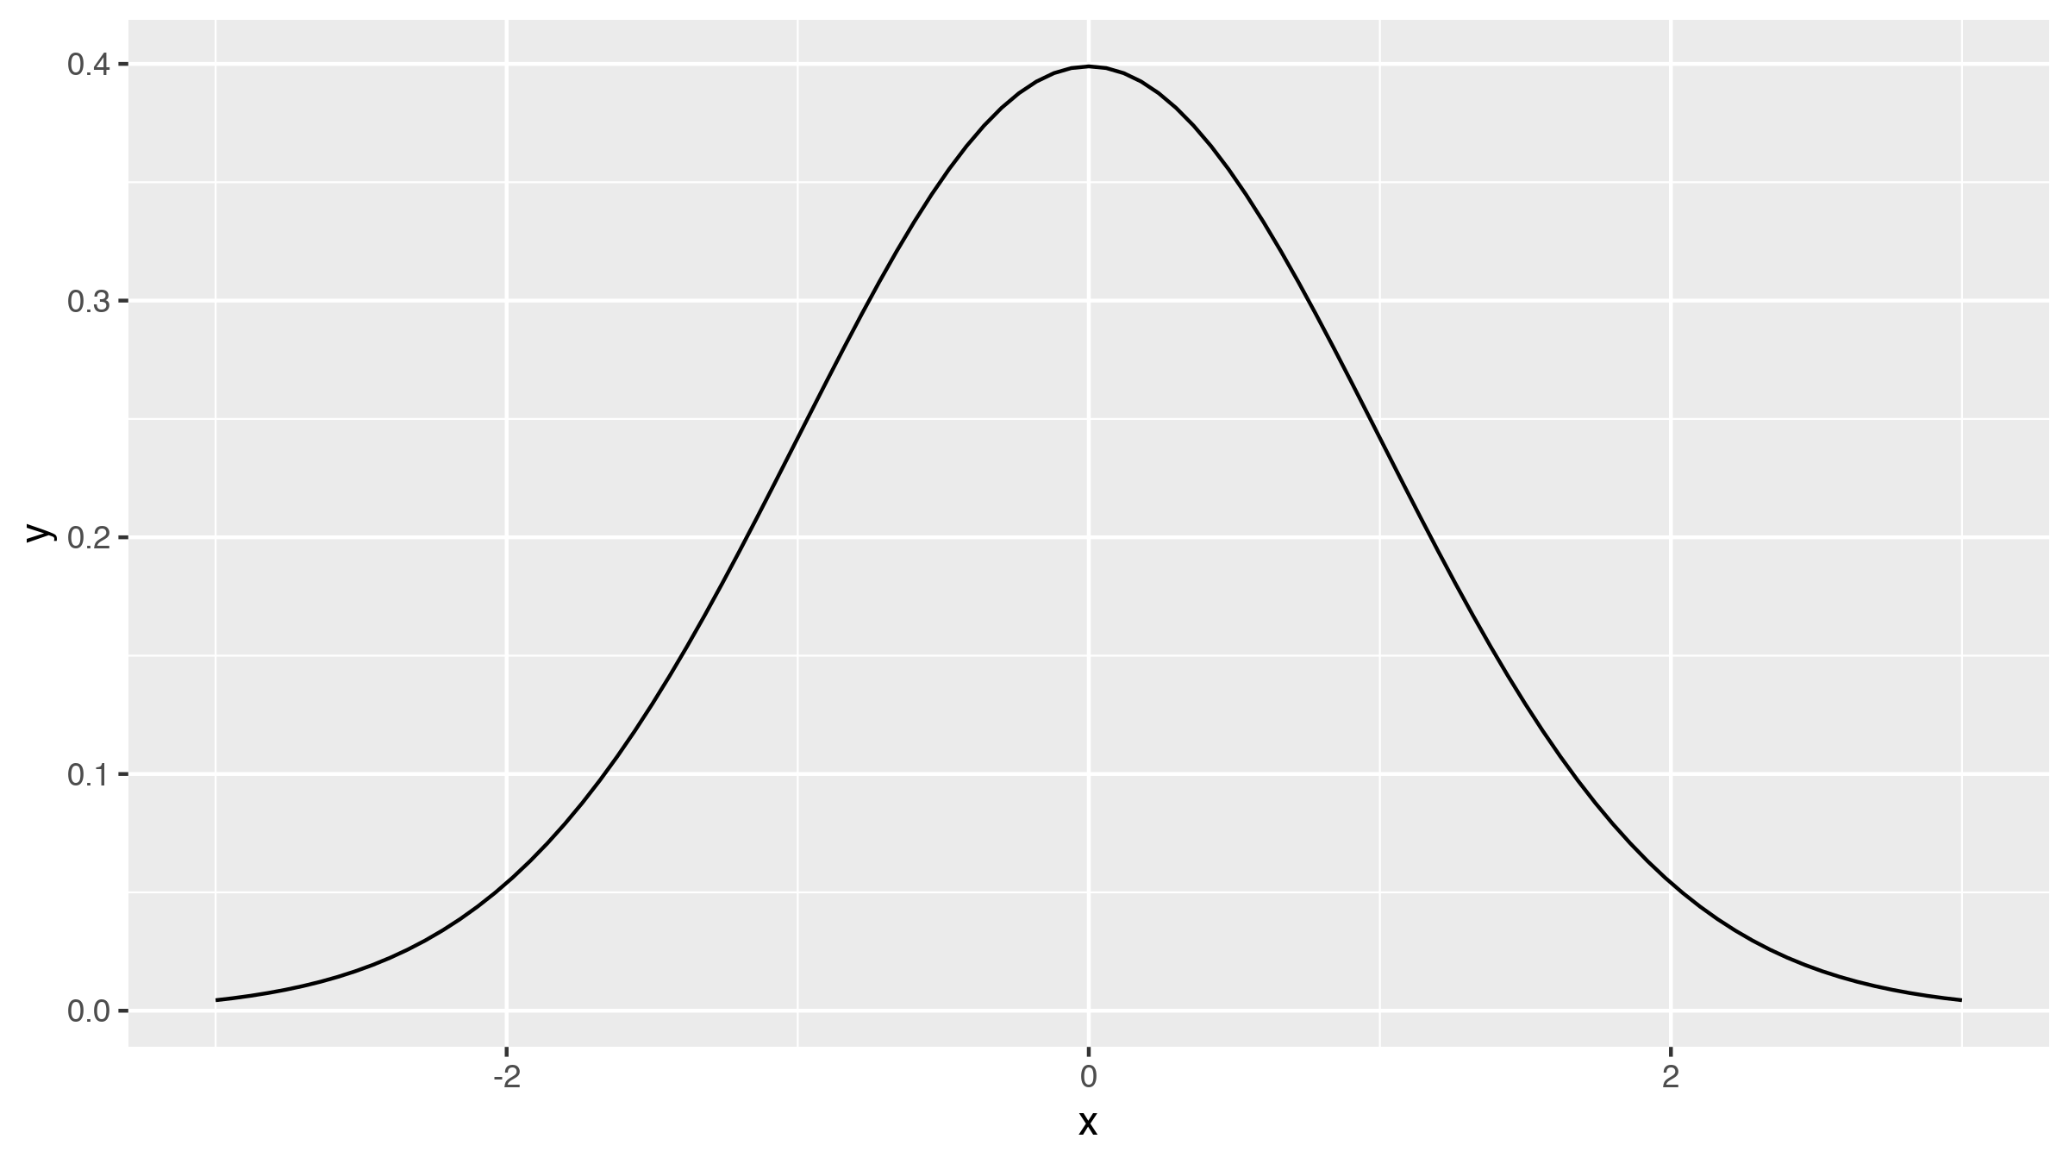
NORMAL DISTRIBUTION

Slide 13
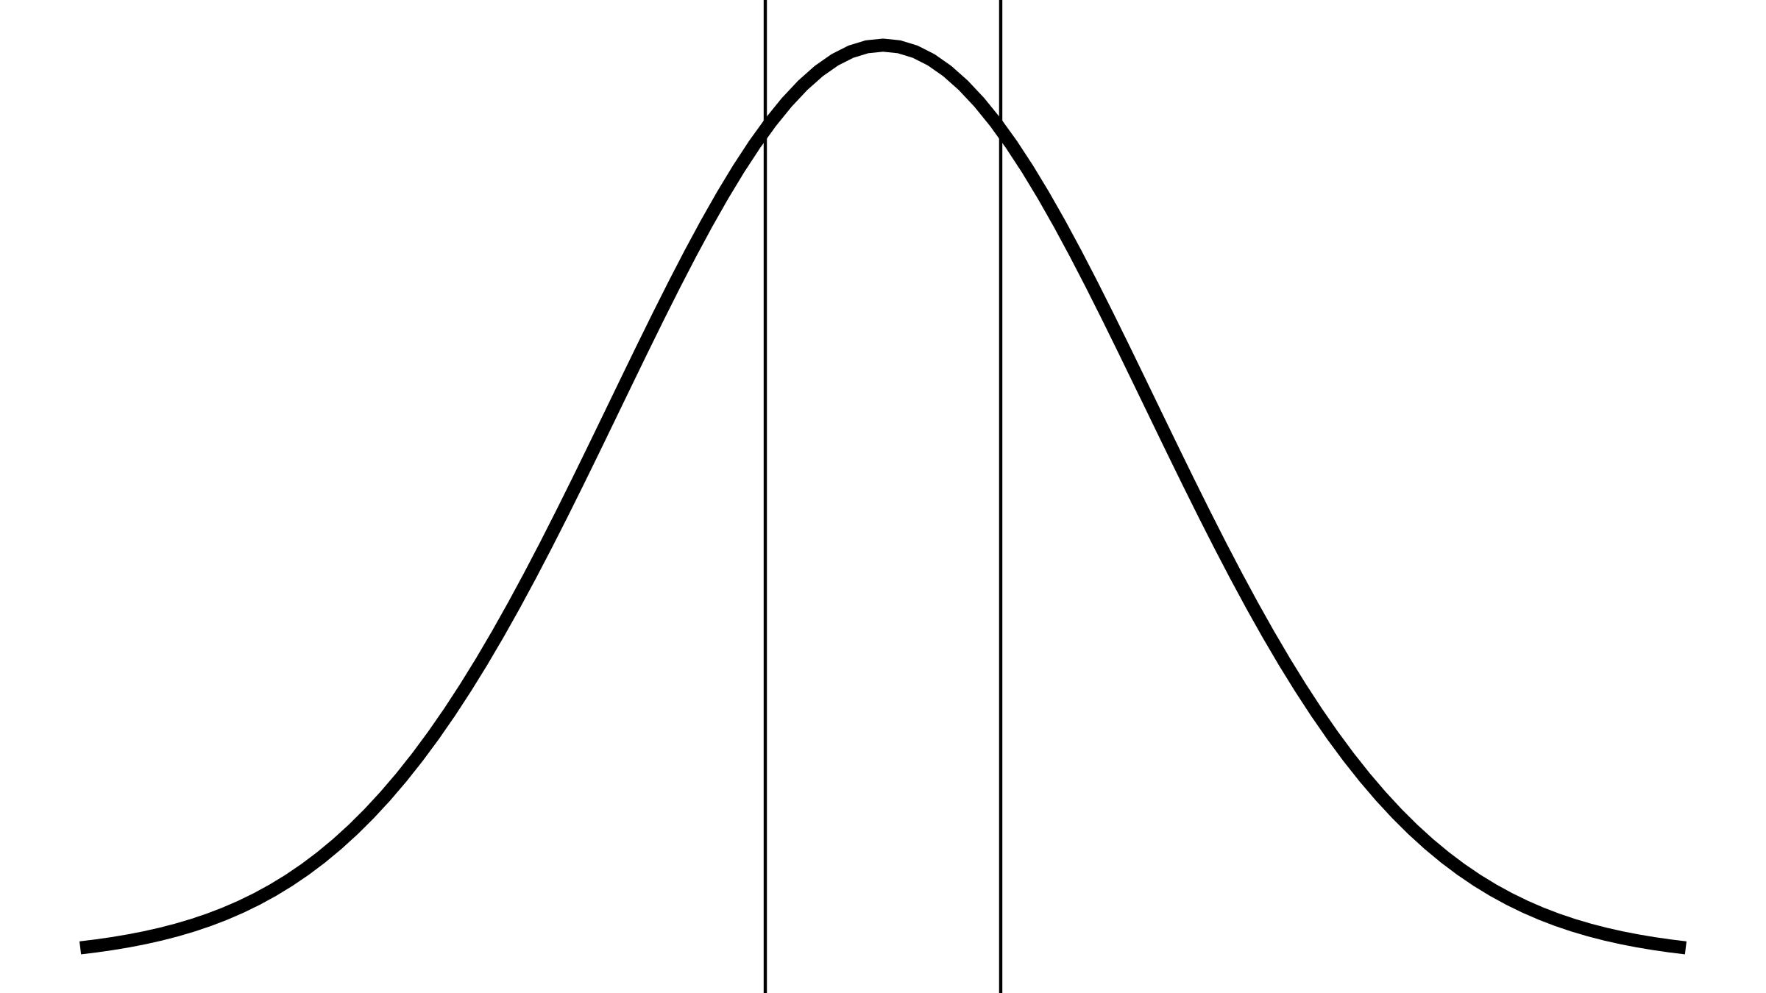
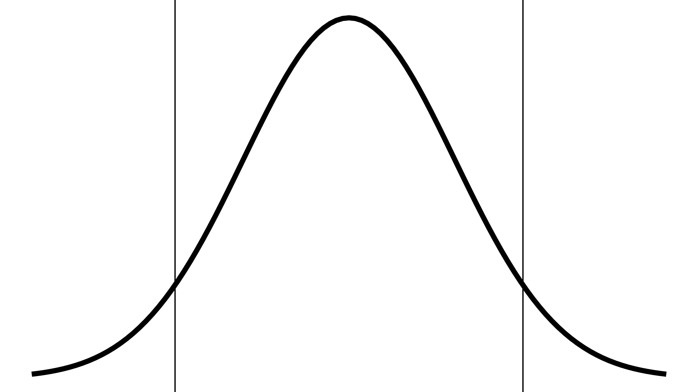
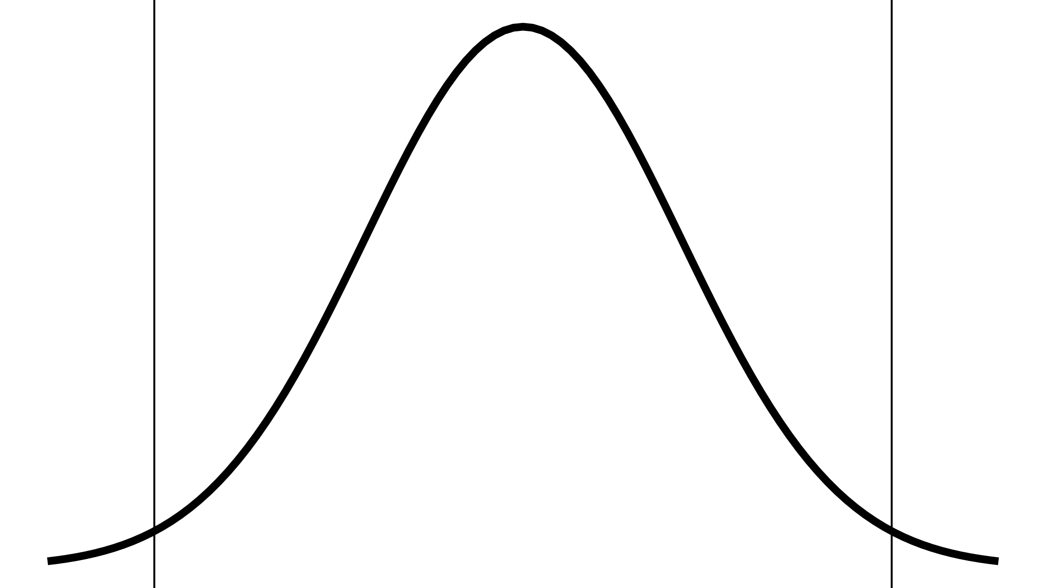
Z-SCORES AND AREAS
1 SD
_{67%}
2 SD
_{95%}
3 SD
_{99%}

Slide 14
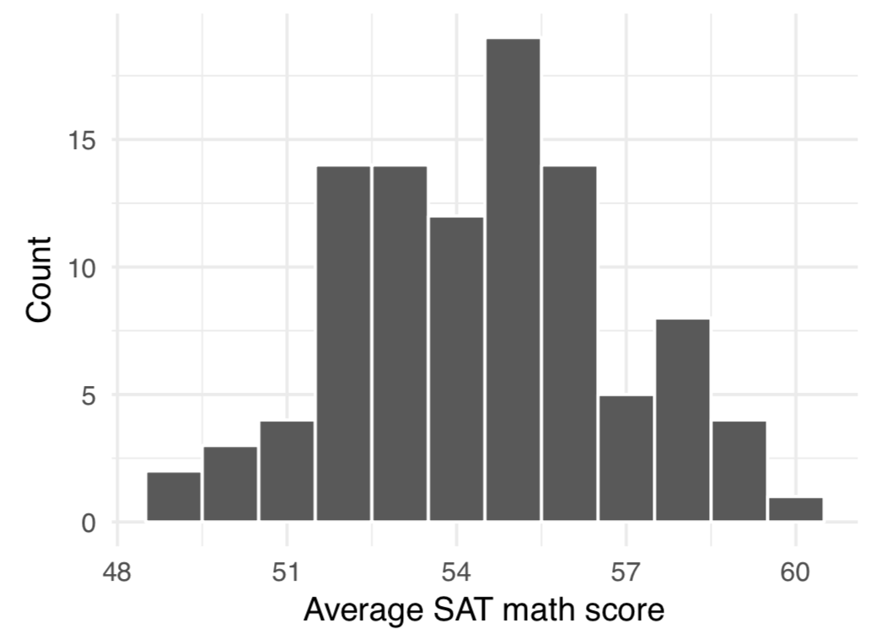
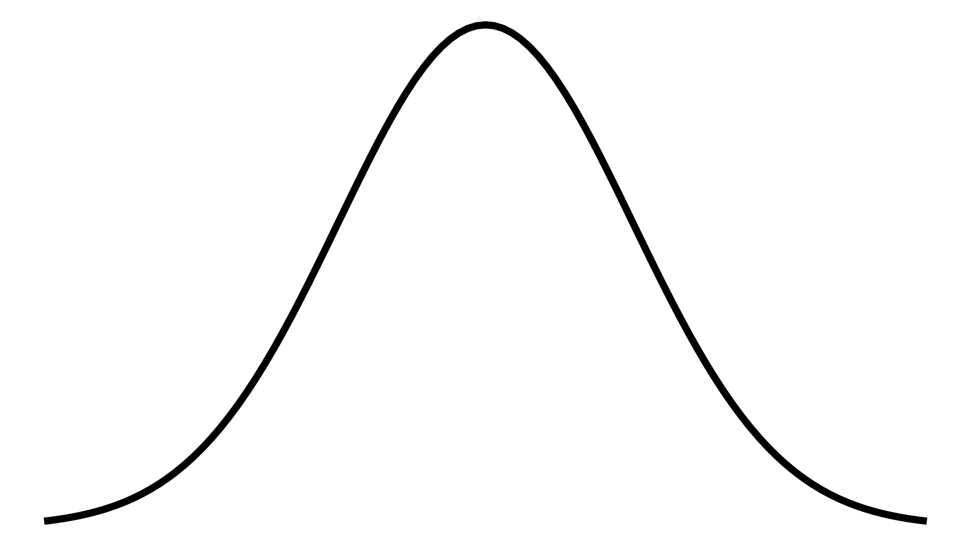

Slide 15
IDEAL SAMPLE SIZES
How many apartments should we sample to generate a 95% confidence interval where we’re ±$50 around the mean?
(Assume the population standard deviation is $200)
Notes:
50 = 1.96 \times \frac{200}{\sqrt{n}}

Slide 16
SAMPLE SIZES IN REAL LIFE
Search Google for “sample size calculator”
https://www.qualtrics.com/blog/calculating-sample-size/
Notes:
50 = 1.96 \times \frac{200}{\sqrt{n}}

Slide 17
NOT EVERYTHING IS NORMAL
What if the data doesn’t fit a normal distribution?
Use a different distribution!

Slide 18
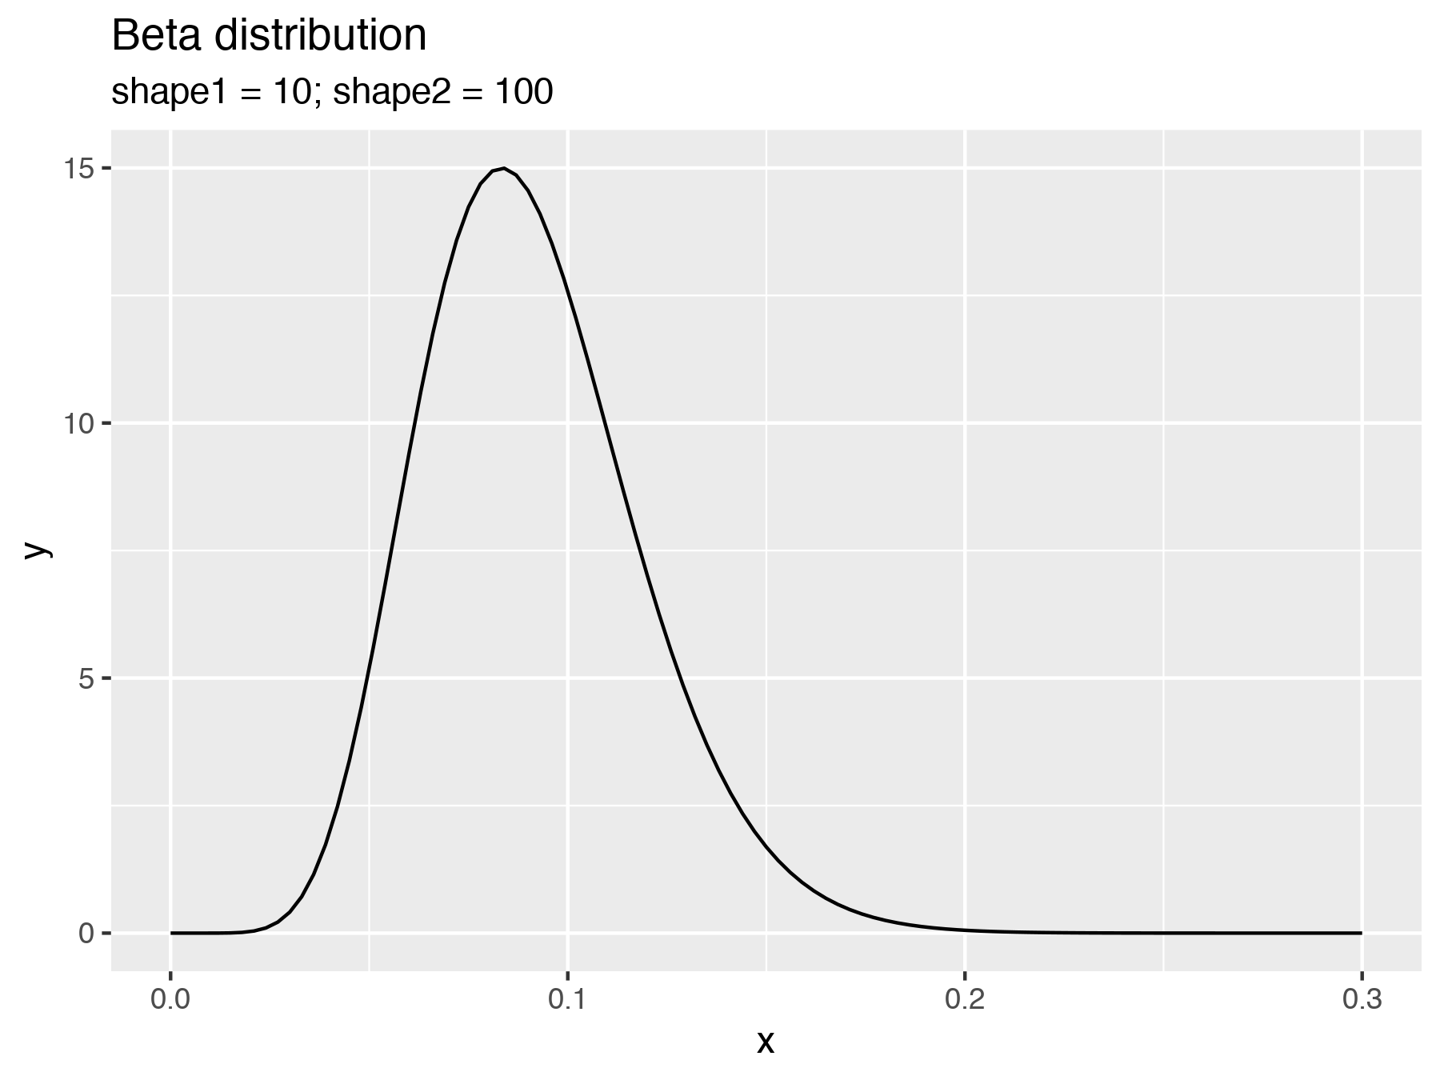
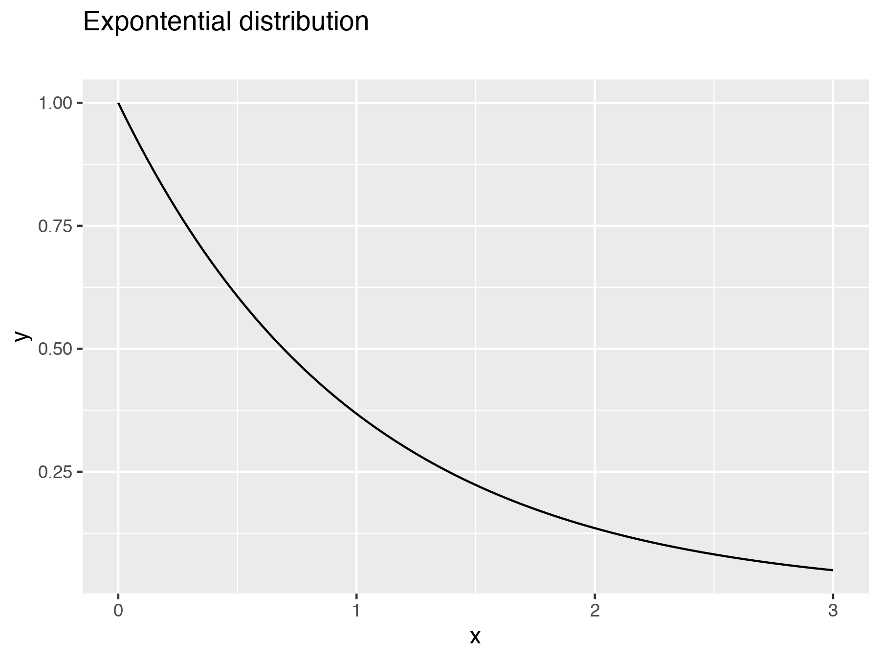
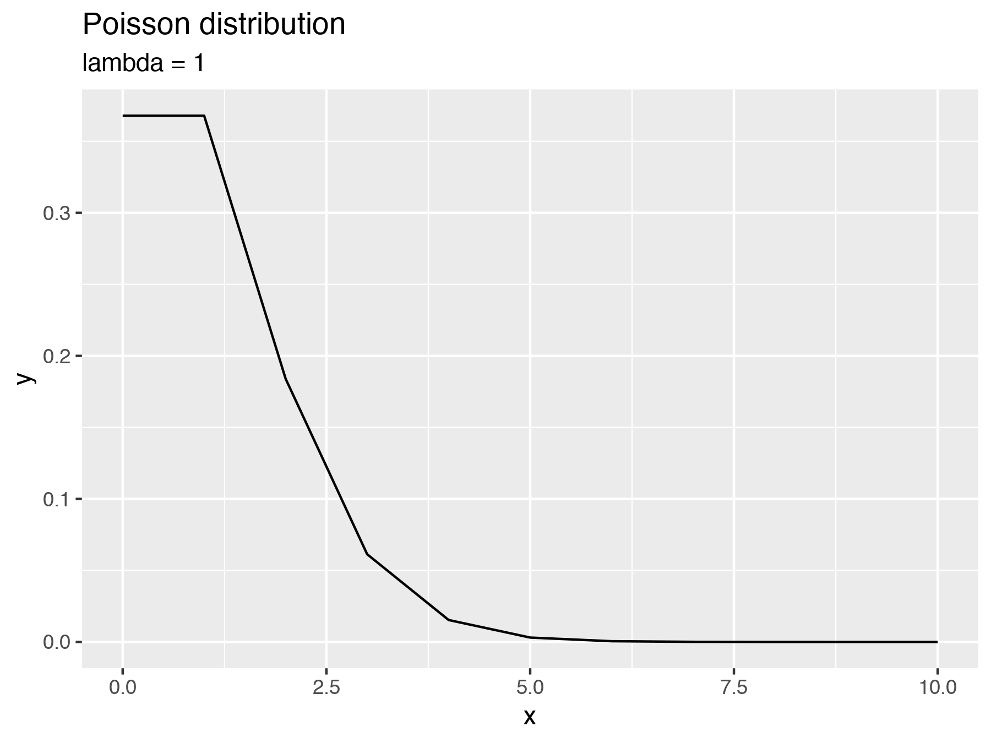
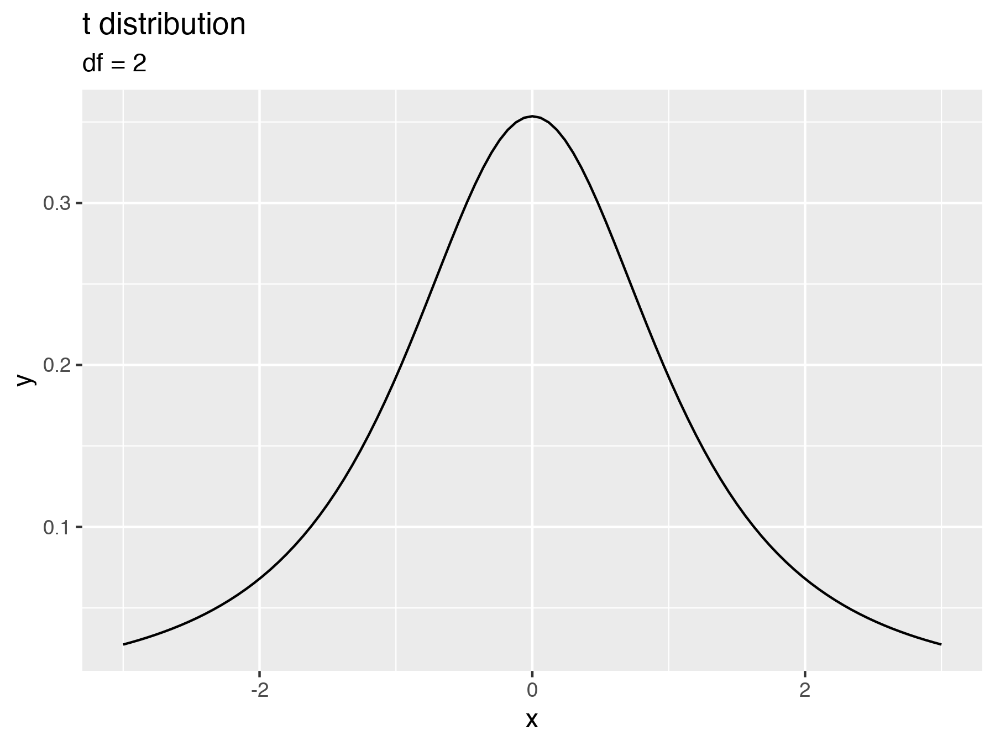

Slide 19
NOT EVERYTHING IS MATHY
What if the data doesn’t fit any of those distributions?
Give up or use one that’s close enough

Slide 20
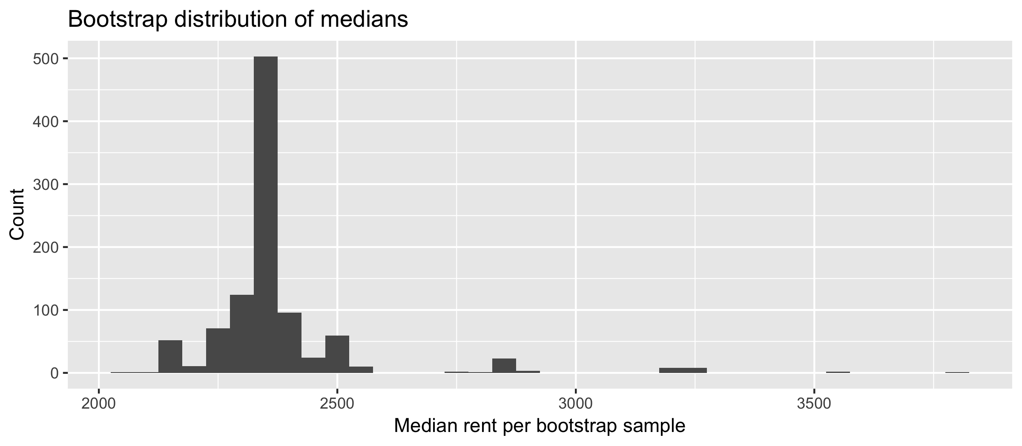
NO GOOD MATHY FIT

Slide 21
NULL HYPOTHESES TOO
In classical statistics, null worlds are just some math formula
We have to hope they fit our data
(hence the complicated flowcharts)

Slide 22
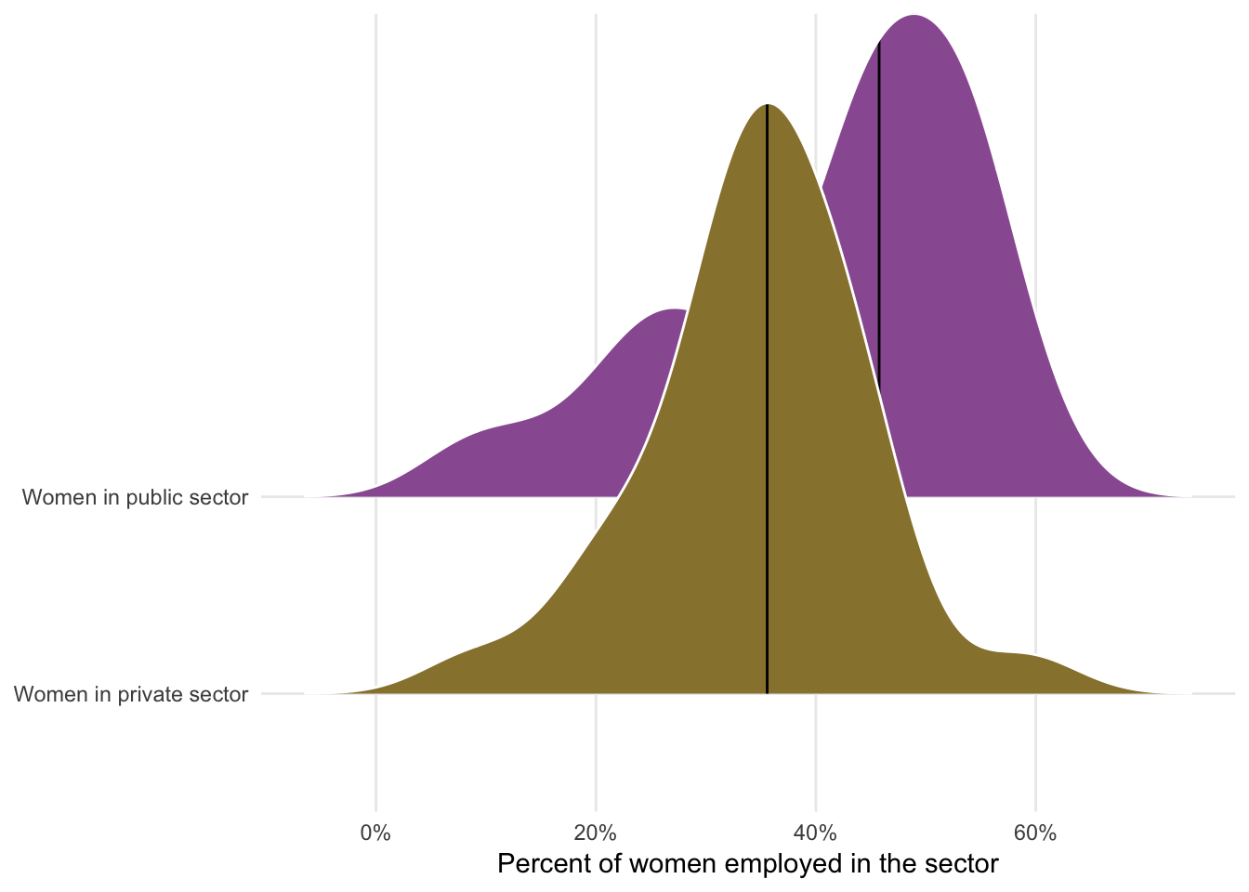
WOMEN AND SECTORS

Slide 23
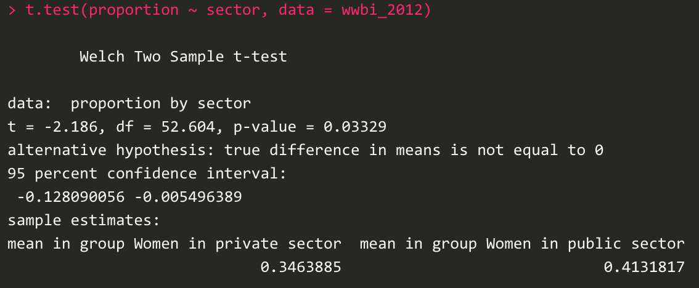
WOMEN AND SECTORS

Slide 24
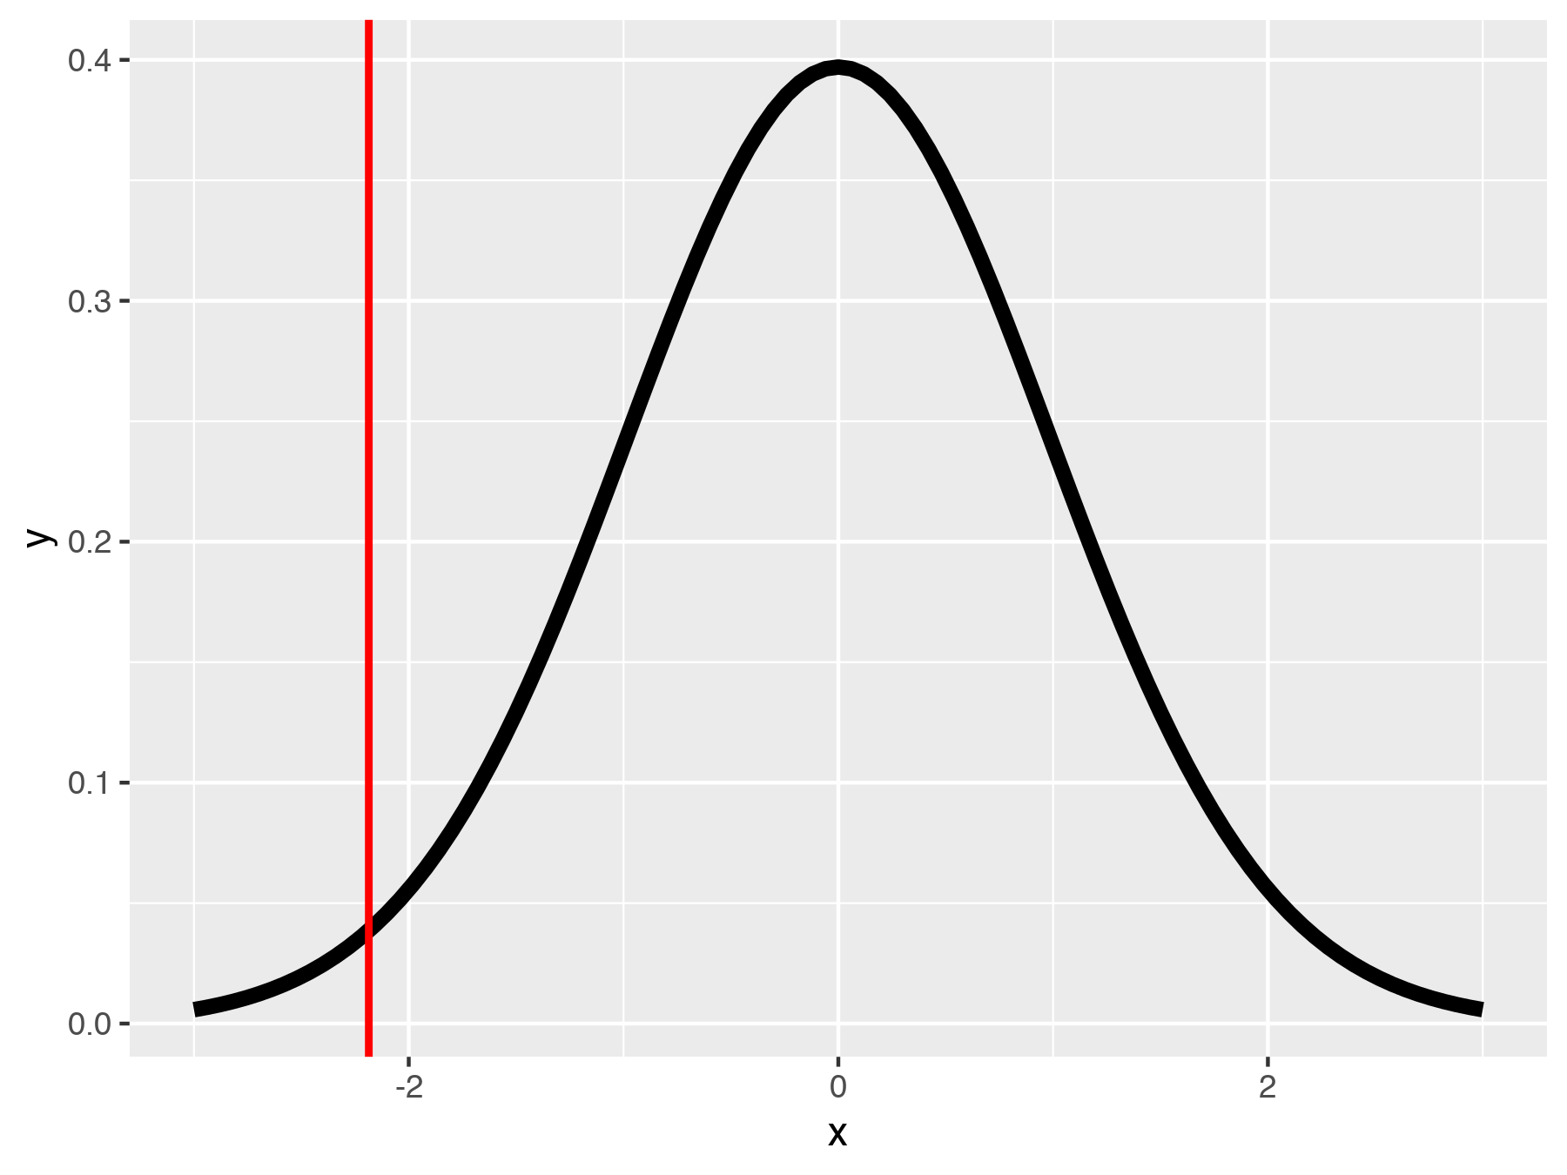
WOMEN AND SECTORS

Slide 25
NULL WORLDS
But how do you determine what δ would look like in a null world?
Option 1: Use math and calculus and formulas to determine probabilities
Option 2: Use brute force with simulation

Slide 26
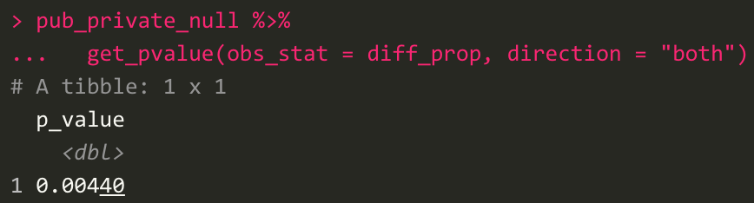
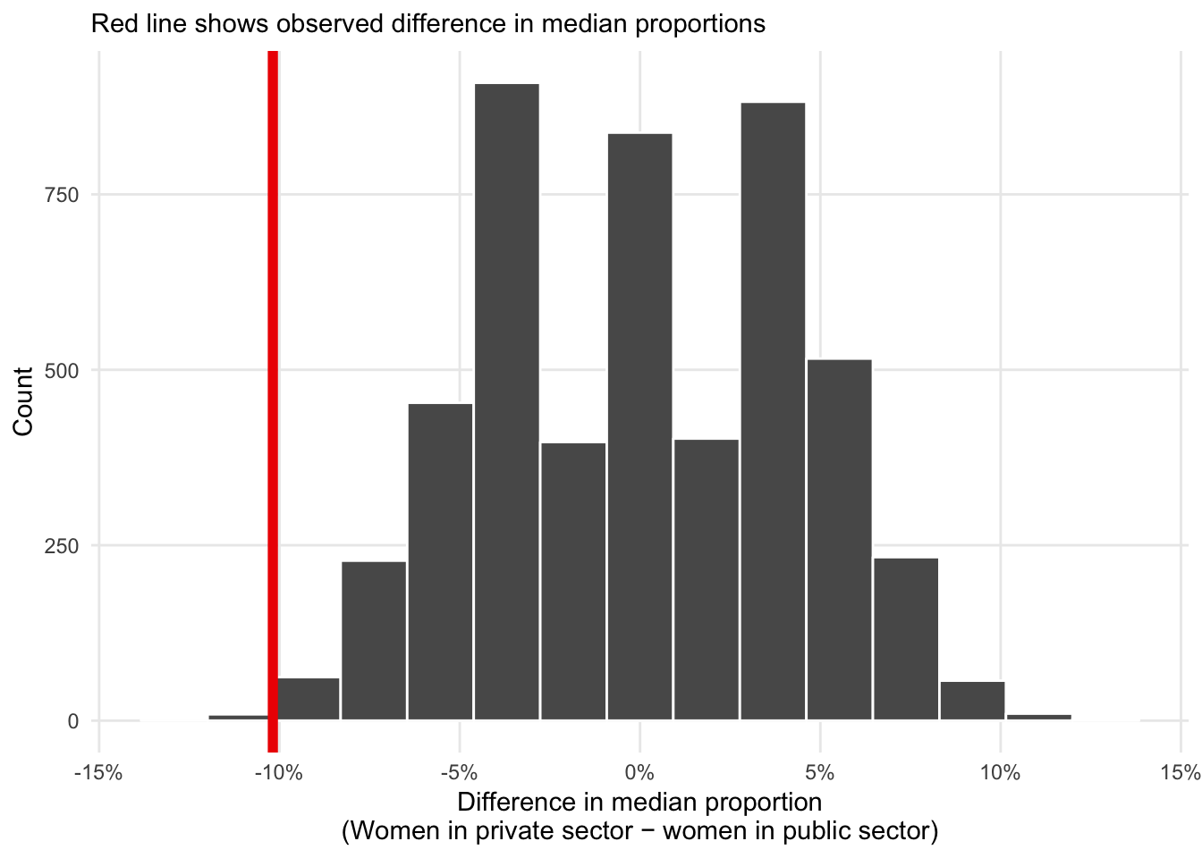
WOMEN AND SECTORS

Slide 27
WHY SIMULATE?
You can test any hypothesis without math and calculus

Slide 28
INFERENCE AND REGRESSION

Slide 29
COEFFICIENTS AND UNCERTAINTY
Every regression coefficient is a δ
Something that reflects the population and might be zero or might not be zero

Slide 30
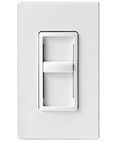
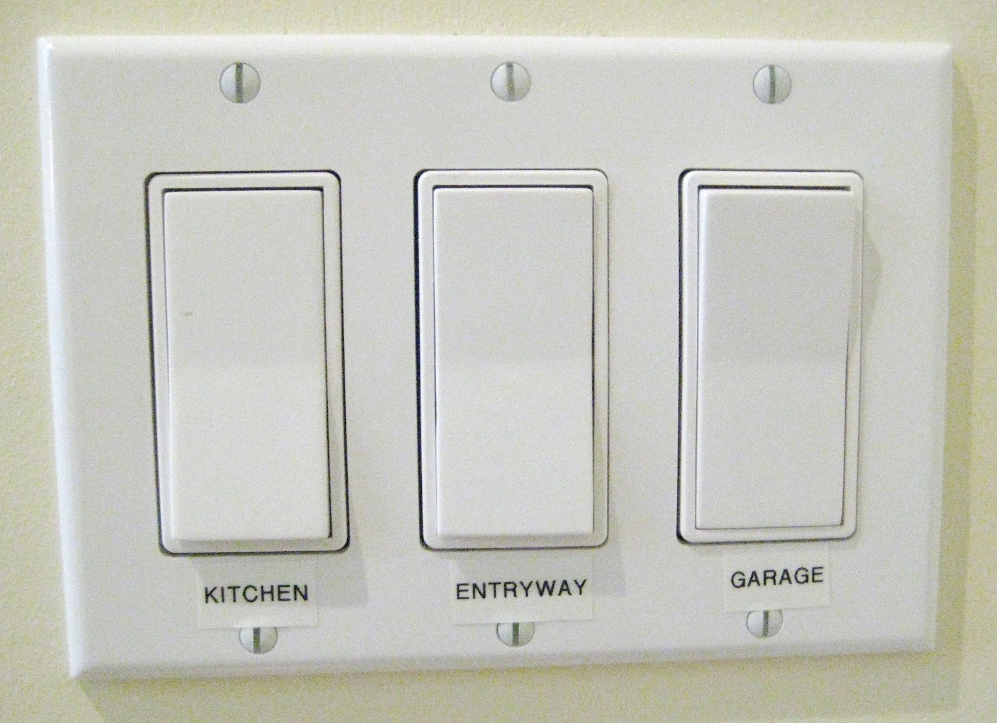
SLOPES AND ZEROES
If a β is 0, Y doesn’t change if X changes
If a β is not 0, Y changes if X changes

Slide 31
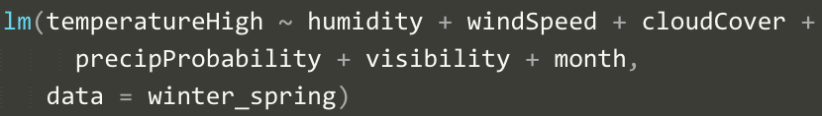
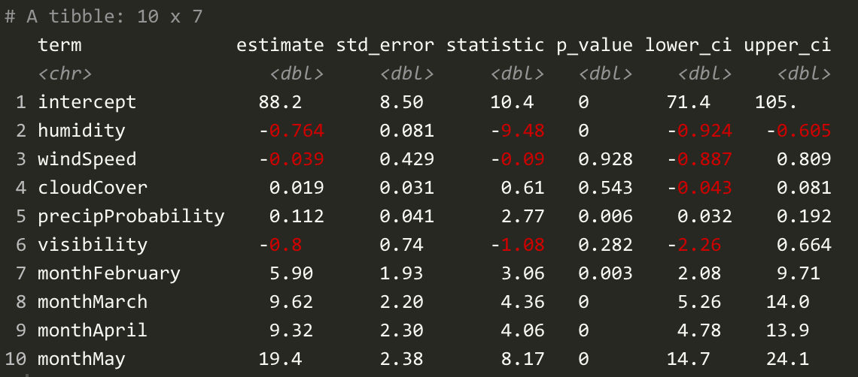

Slide 32
term | estimate | std_error | statistic | p_value
intercept | -412.5 | 118.1 | -3.493 | 0.001
median_home_value | 0.004 | 0 | 21.99 | 0
prop_houses_with_kids | 14.09 | 2.853 | 4.941 | 0
stateCalifornia | 123.3 | 88.22 | 1.397 | 0.164
stateIdaho | 9.526 | 82.74 | 0.115 | 0.908
stateNevada | 102.5 | 98.25 | 1.043 | 0.299
stateUtah | -213.2 | 91.21 | -2.337 | 0.021

Slide 33
term | estimate | std_error | statistic | p_value
intercept | -2.821 | 1.355 | -2.083 | 0.04
life_expectancy | 0.102 | 0.017 | 5.894 | 0
school_enrollment | 0.008 | 0.01 | 0.785 | 0.435
regionEurope & Central Asia | 0.031 | 0.255 | 0.123 | 0.902
regionLatin America & Caribbean | 0.732 | 0.294 | 2.489 | 0.015
regionMiddle East & North Africa | 0.189 | 0.317 | 0.597 | 0.552
regionNorth America | 1.114 | 0.581 | 1.917 | 0.058
regionSouth Asia | -0.249 | 0.45 | -0.553 | 0.582
regionSub-Saharan Africa | 0.326 | 0.407 | 0.802 | 0.425

Slide 34
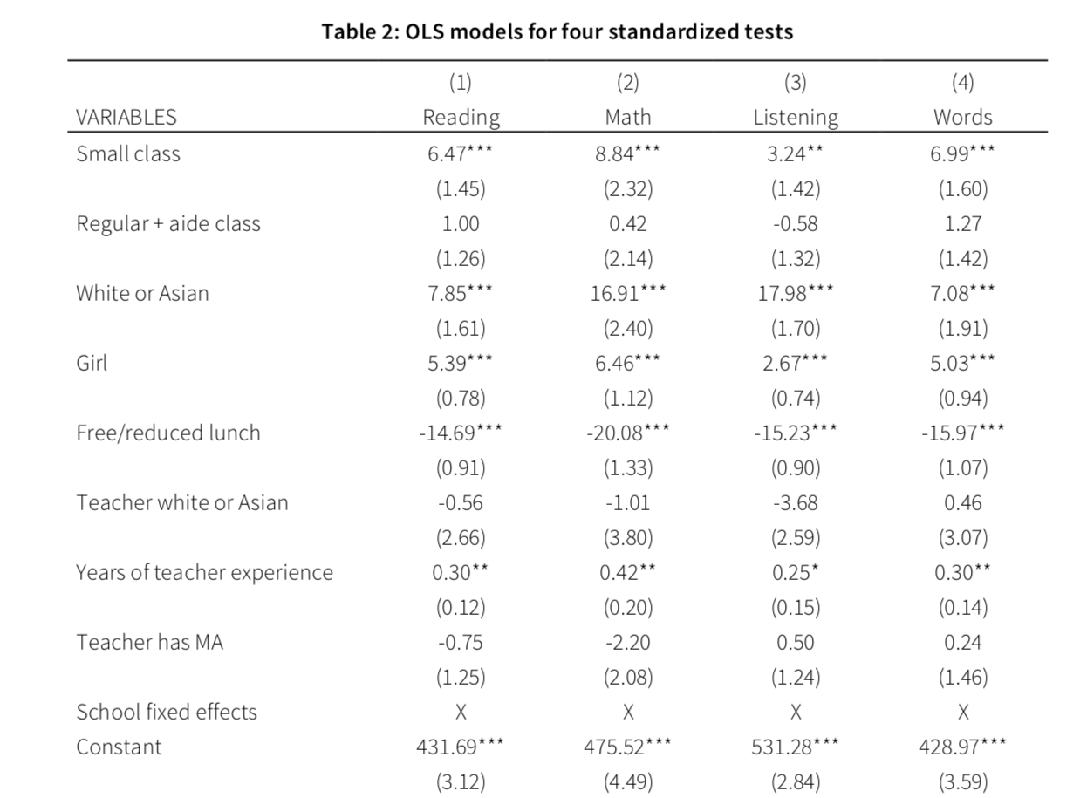
Y = test scores
Not small vs. small
Class doesn’t have aide vs. class has aide
Student not white/Asian vs. yes
Student is boy vs. girl
Student does not receive FRL vs. yes
Teacher not white/Asian vs. yes
Years (actual number)
Teacher does not have MA vs. yes
*** p < 0.001, ** p < 0.01, * p < 0.05

Slide 35
TELLING STORIES WITH DATA

Slide 36
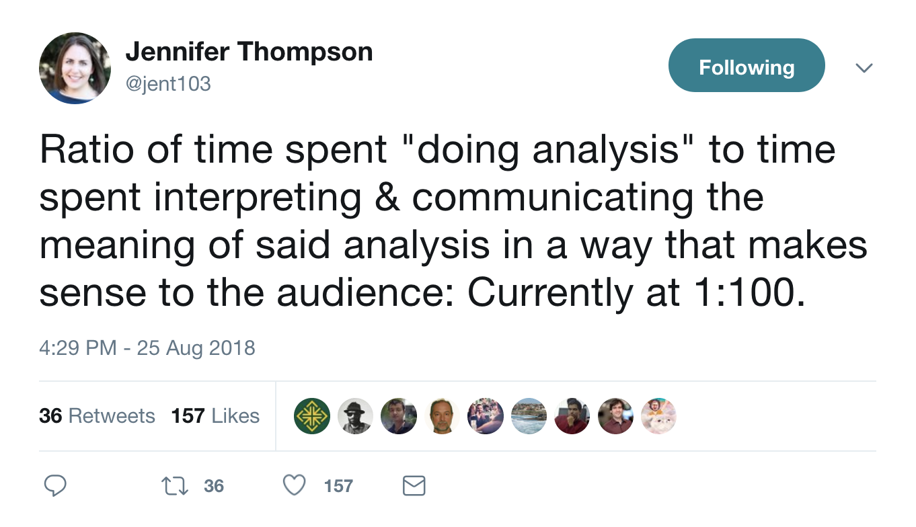
Notes:
https://twitter.com/jent103/status/1033481434072317957?s=12

Slide 37
Stories are how we translate core, essential content to different forms for specific audiences

Slide 38

EVERY STORY IS THE SAME
https://www.youtube.com/watch?v=LuD2Aa0zFiA

Slide 39
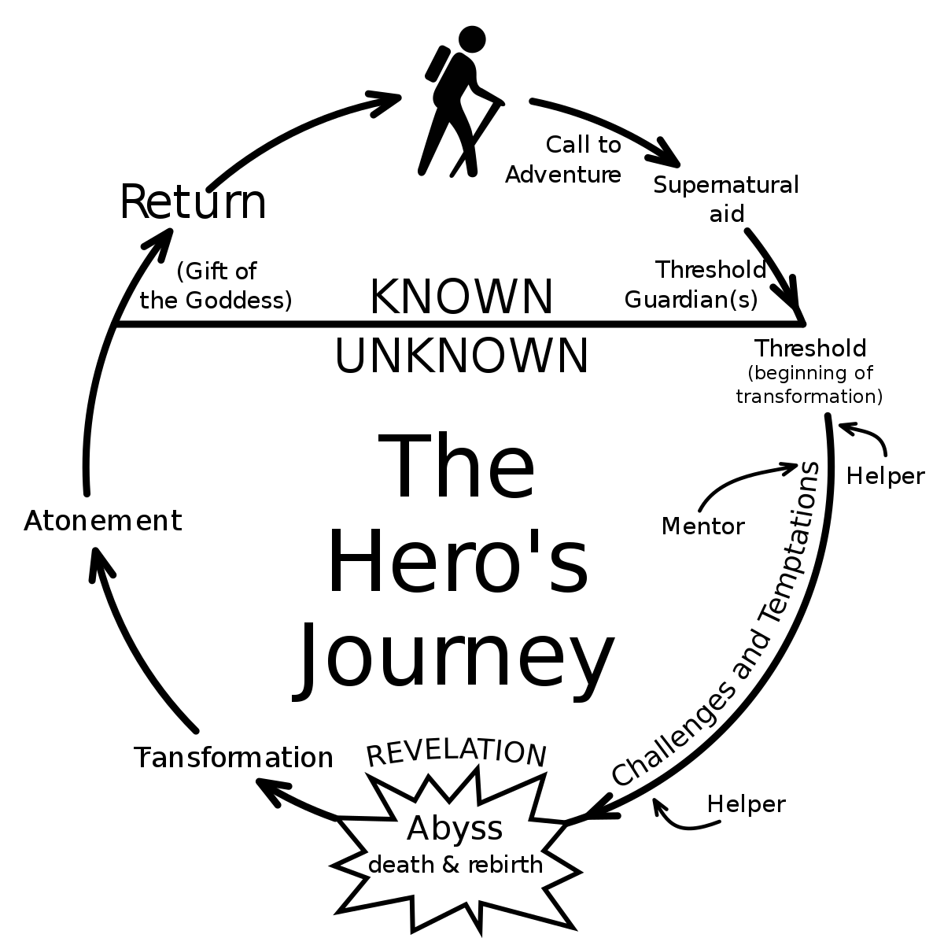

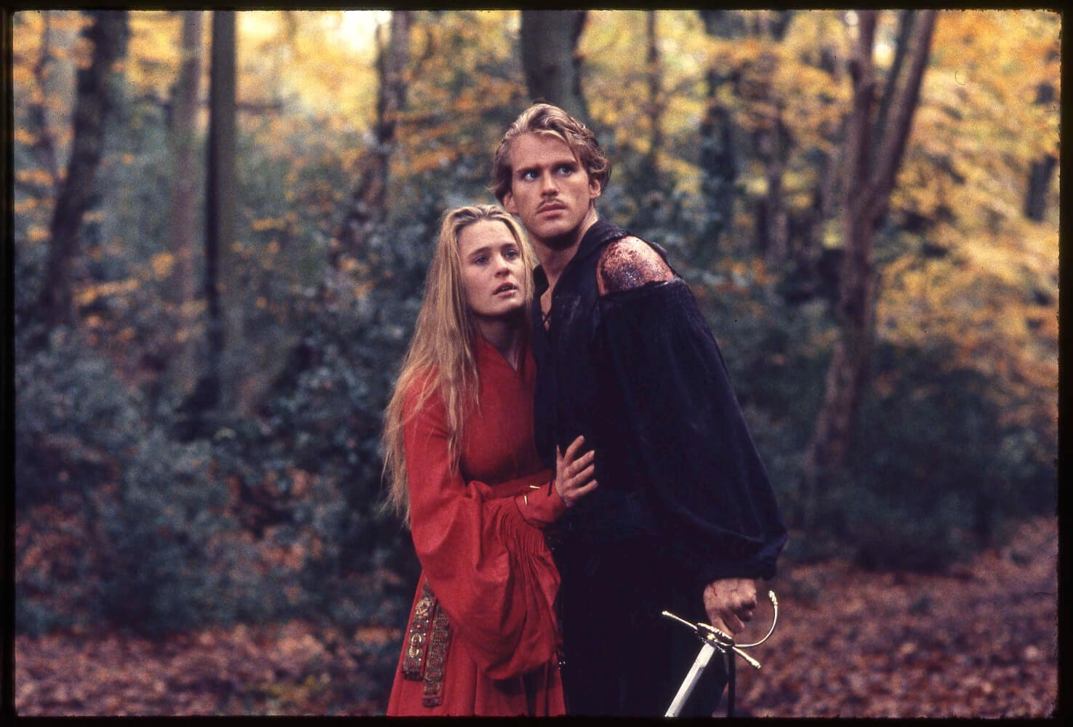
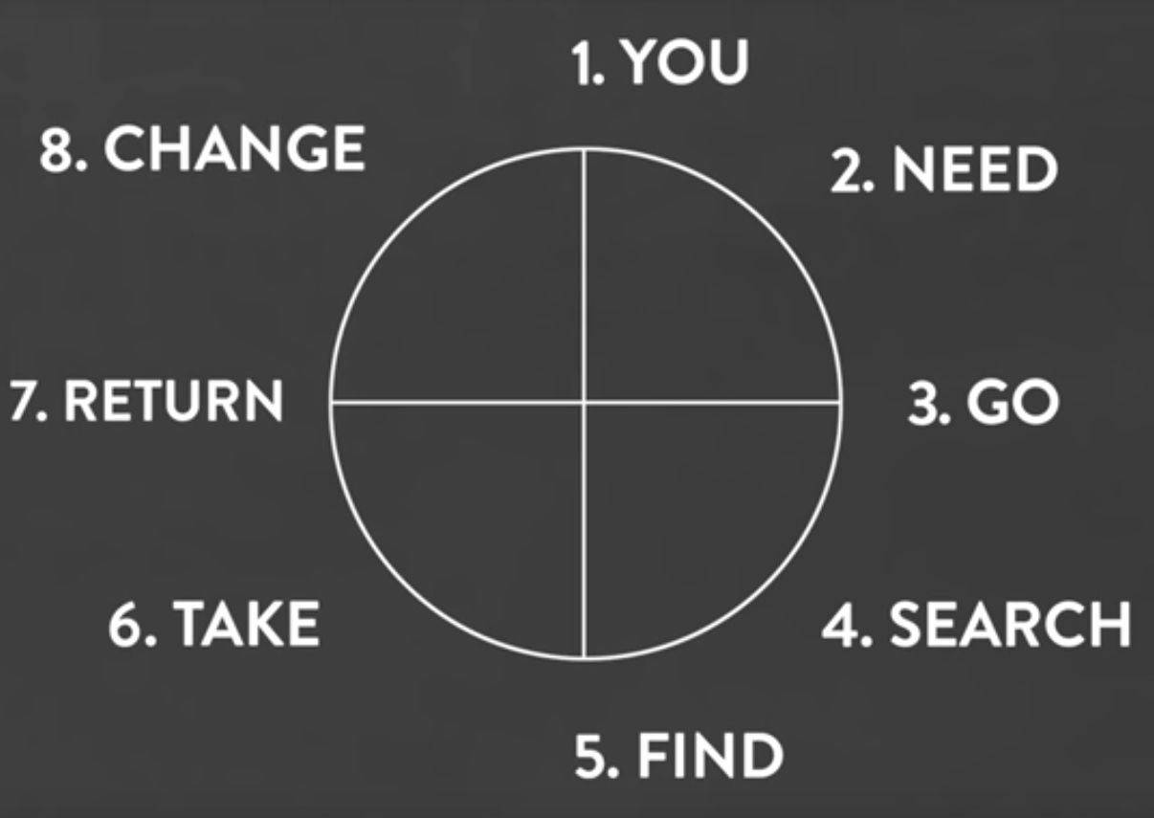
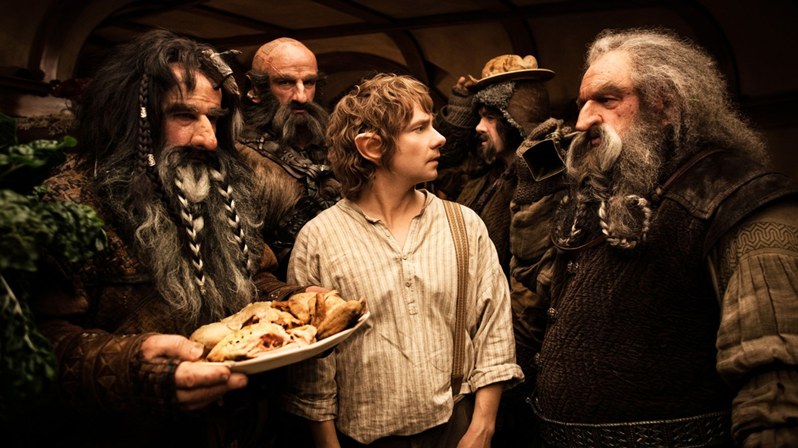

Slide 40
What does this all have to do with statistics and data analysis?
Who is the hero?

Slide 41
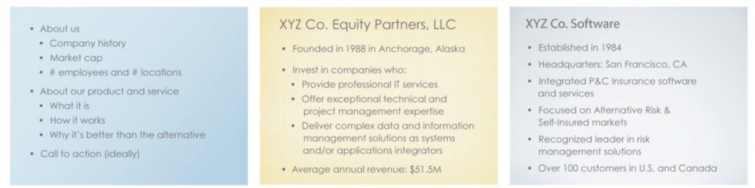
You are not the hero.

Slide 42
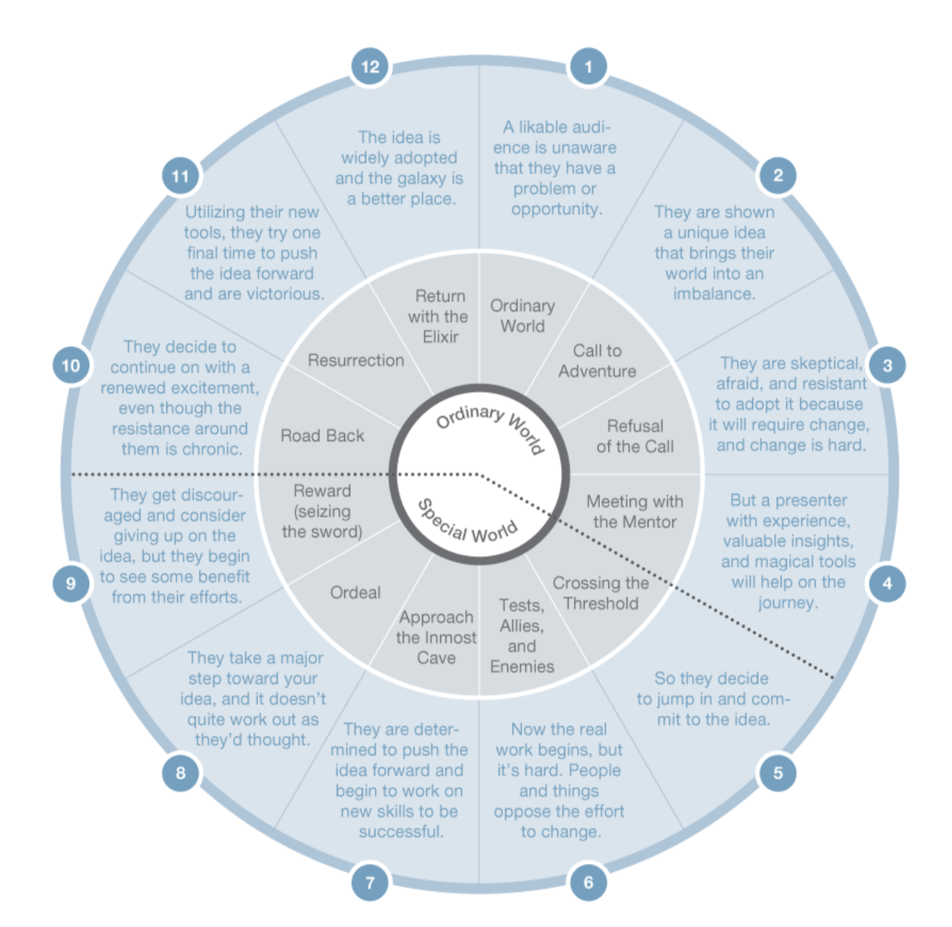

Slide 43
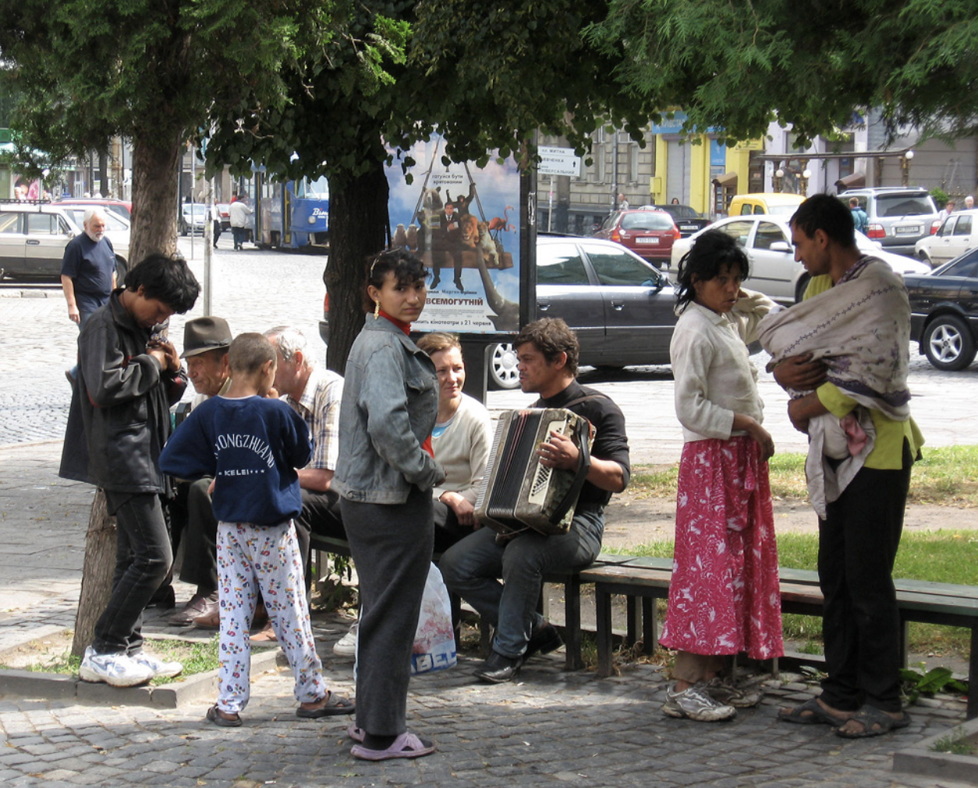
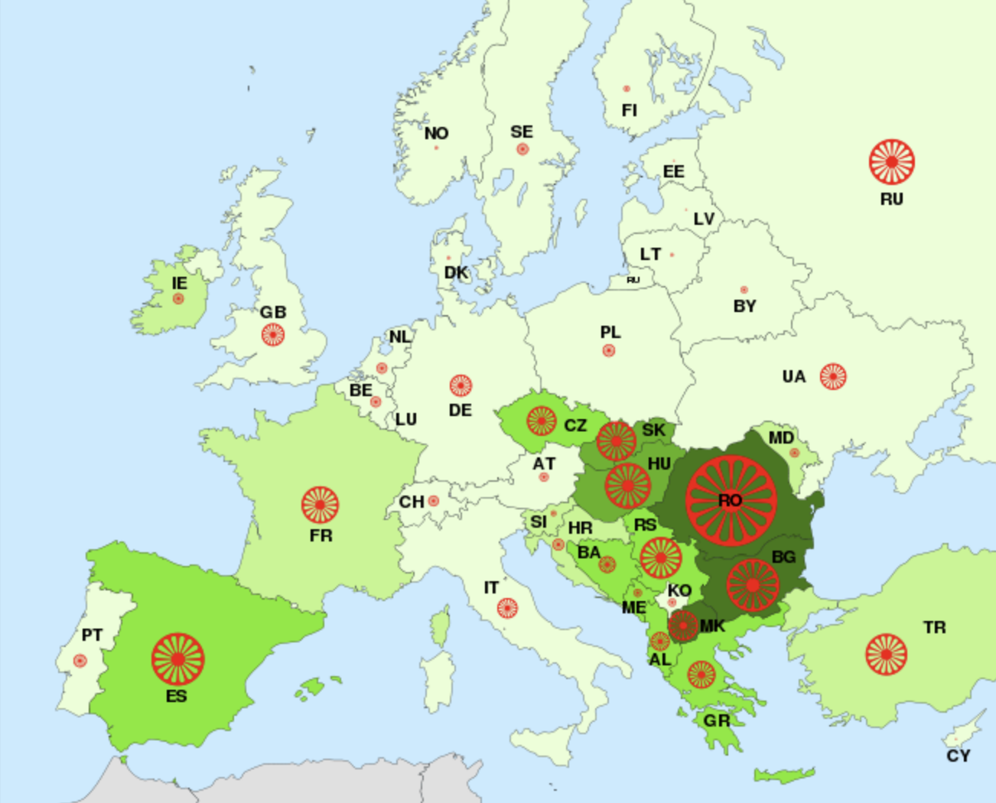

Slide 44
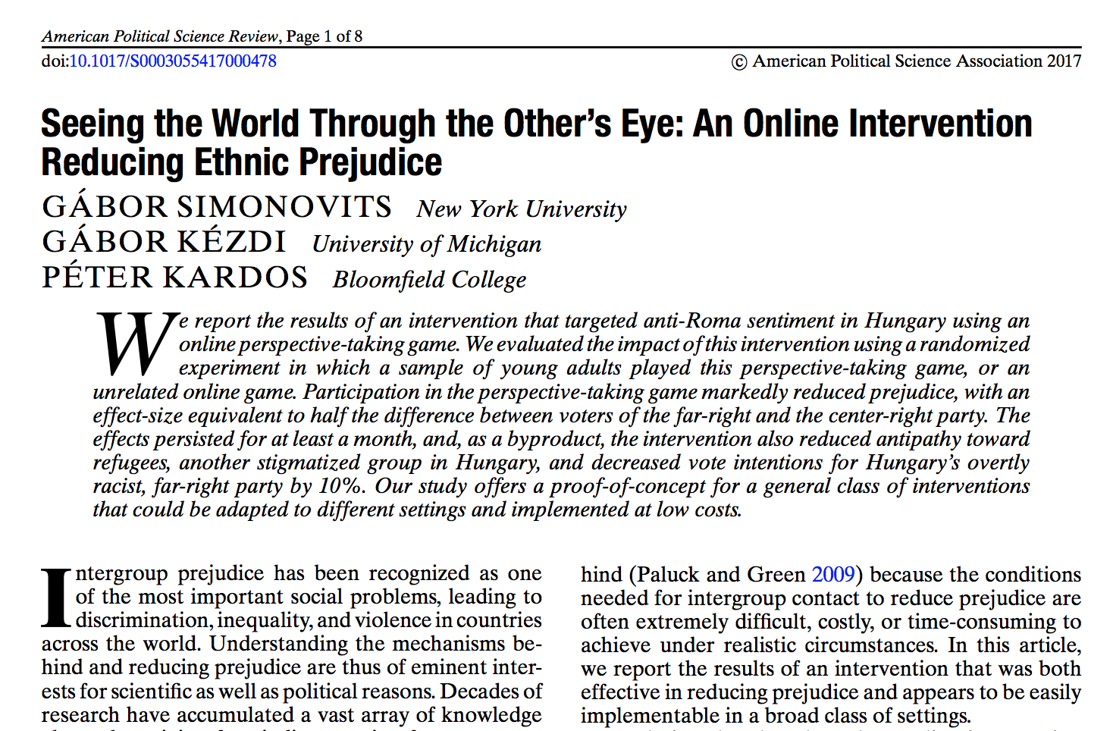

Slide 45
You were born eighteen years ago, in June in a Gypsy settlement near Szekszard. Your mother, as you know, long-dead, no news about your father. You might have some siblings somewhere in the country, but you never met them… Entangled dreams and stories swirl in your head. You are scared, but you know that now you can achieve anything. Your net worth of two hundred and ten thousand forints is all in your pocket, that is what you received from the state after all the deductions. You nervously feel your dress as the train rolls in between the platforms.
You are browsing through some websites offering housing and feel the notes in your pocket. You pick the four sublets that look the best among those you could possibly afford. One might be a little overpriced, but all of them offer immediate move in. You call each of the landlords, and agree to check each of them out.
Choose which one you visit first:
• You go to the one on Nemet street
• You go to the one on Rozsa street
• You go to the one on Dob street
• You go to the slightly expensive one on Jokai street
Prejudice toward Roma ↓
Center right
Far right
Side effects
Prejudice toward refugees ↓
Support for far right party ↓

Slide 46


Slide 47
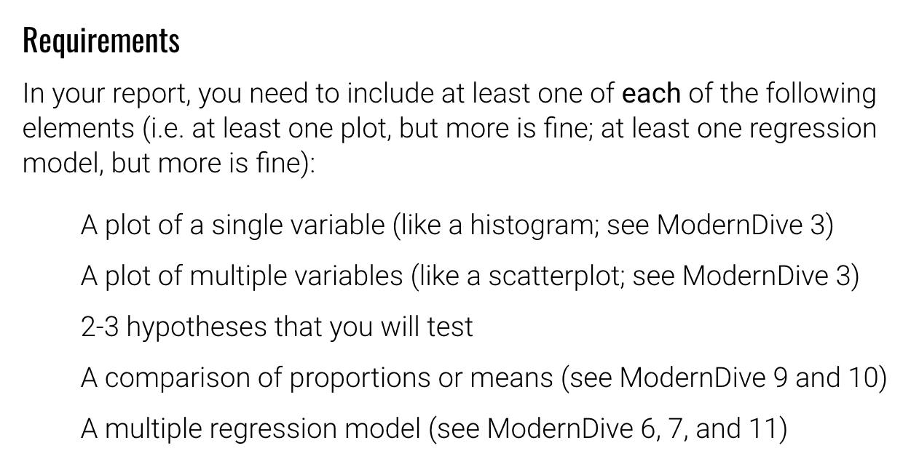

Slide 48
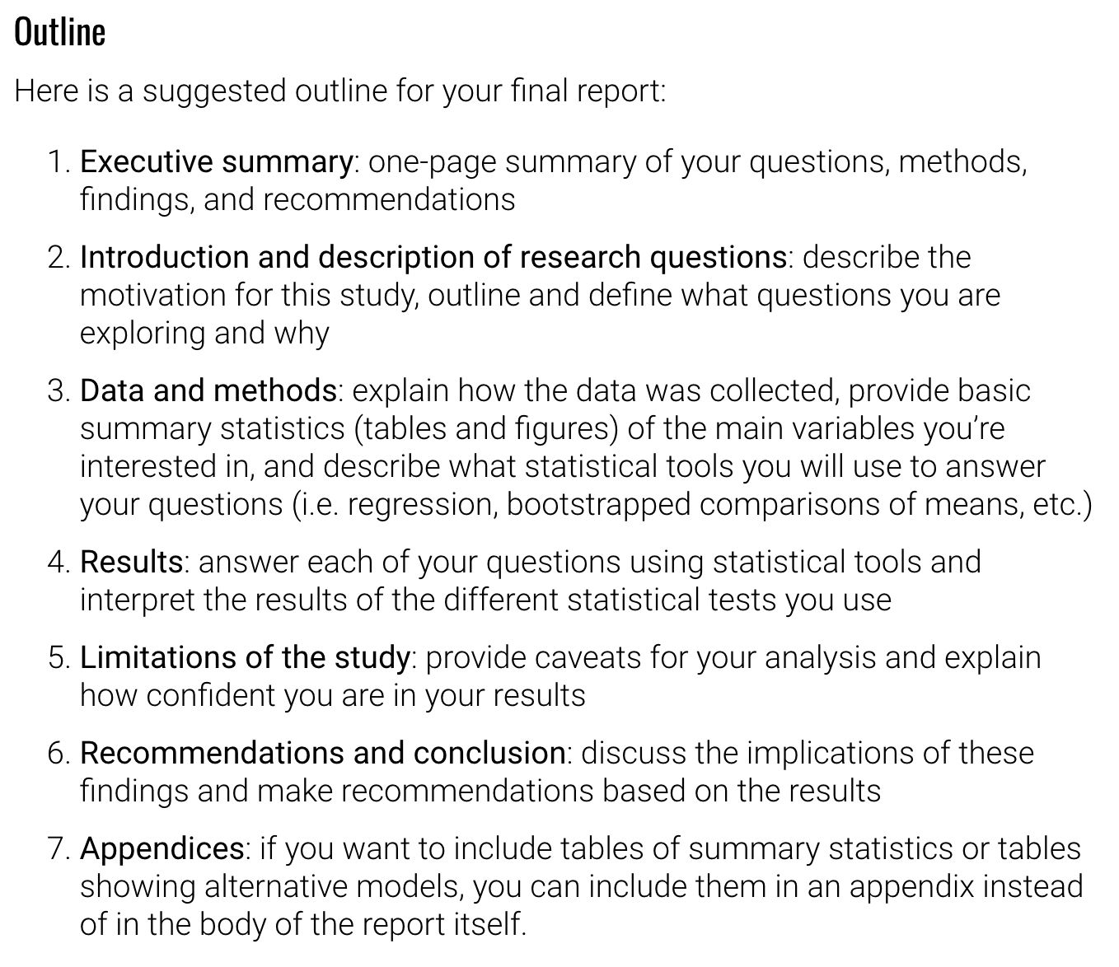

Slide 49
Check the storyness of your final project
Does it take the audience on a journey?

